Slide 1
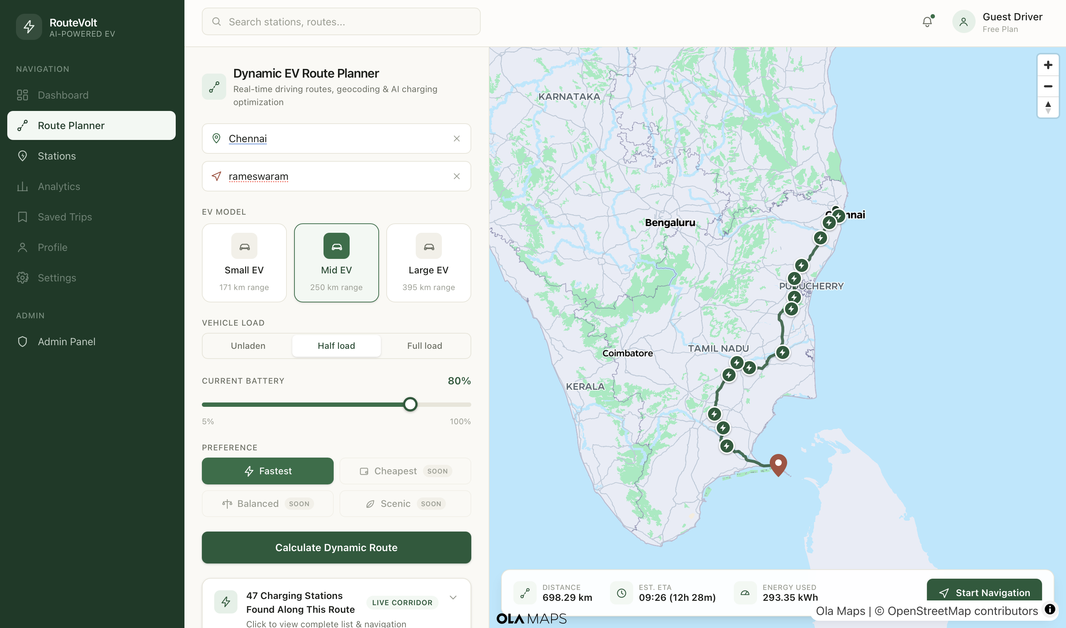
OFFICIAL PROJECT PITCH TEMPLATE
RouteVolt
Plans your EV's entire charging strategy — where to stop, how much to charge, and what to do if a charger lets you down.
INSERT A LIVE
APP SCREENSHOT HERE
PROJECT SNAPSHOT
RouteResults.jsx: charging stops, charge-to-% targets, and ranked backup stations
SDG 11 — Sustainable Cities • Intercity EV drivers in Tamil Nadu • Working prototype (TRL 4–5)
TEAM
Team Souls | Rajalakshmi Institute of Technology
S. Giridharan (Lead) • Dinesh Azhagu Sankar P • S. Abinash
01 / 08
Notes:
SAY: "RouteVolt tells you exactly how much charge your EV trip will cost — before you commit to it — and plans the charging stops for you." Then name the team and college.
VISUAL: swap the placeholder for a real screenshot of RouteResults.jsx (Route A/B/C with predicted kWh + arrival battery) before presenting.
TECH DETAIL: prototype stage is TRL 4-5 — a working FastAPI + React app tested locally, not yet field-piloted.
LIKELY Q: "Is this live/deployed?" A: No — it's a working local prototype (FastAPI backend, React frontend, real routing/elevation/traffic APIs), not yet deployed for public use.

Slide 2
02
DEFINE
The problem worth solving
Make the problem specific, evidence-based and human - not just a broad topic.
!
PROBLEM IN ONE SENTENCE
EVIDENCE
EV travel in india lacks an intelligent trip strategy that continuously decides the right stops, charge levels, and backups while accounting for charger availability and queues—making long-distance travel unnecessarily stressful and inefficient.
6 connector standards, 30+ raw names
WHY NOW?
Found while building the station graph our planner runs Dijkstra over — proof that managing charging decisions here by hand is genuinely hard.
U
WHO FEELS IT?
N
Every stop is a fresh set of decisions — and our own 449-station dataset shows 6 connector standards hiding under 30+ inconsistent names, making each one harder
Drivers default to worst-case over-charging — because no trustworthy predicted number exists today
PlugShare, Google Maps, Tata Power EZ Charge surface charger pins; none decide the stop sequence, charge target or backup plan for you
EV owners driving intercity routes (e.g. Chennai ↔ Trichy, Chennai ↔ Coimbatore)
Tamil Nadu highways and arterial roads, where elevation and traffic swing a lot leg to leg
Every charging stop — deciding where, how much, and what's next
SOURCE / VALIDATION
RouteVolt's own consolidated Tamil Nadu charging-station dataset (449 stations)
02 / 08
Notes:
SAY: today's EV apps show you where chargers are, not what a specific trip will actually cost your specific vehicle. That gap is what RouteVolt closes.
VISUAL: the EVIDENCE card uses a real number from our own data work — 6 connector standards found hiding under 30+ raw naming variants across 449 stations we catalogued — as concrete proof the charging landscape is genuinely fragmented.
TECH DETAIL: connector_normalizer.py maps ~30 raw CSV strings into 6 canonical buckets (CCS2, AC_TYPE2, CHADEMO, BHARAT_DC, TYPE1_16A, UNKNOWN).
LIKELY Q: "Do you have a market-size number or survey data?" A: Not yet — we deliberately did not fabricate one. Our evidence is our own charging-station dataset, not a market-size claim.

Slide 3
03
DEFINE
User insight + SDG alignment
Show that you understand the person behind the problem and the sustainable outcome you are targeting.
PRIMARY USER
SDG ALIGNMENT
Arun, 34 — intercity EV driver (representative persona)
SDG 11
Sustainable Cities and Communities
USER
Owns a mid-range EV, drives Chennai to Madurai for work monthly
Reliable range planning removes a real barrier to EV adoption on intercity corridors, supporting sustainable transport infrastructure across Tamil Nadu.
JOB TO BE DONE
“When I plan a long EV trip, I need something to plan my charging stops and decide how much to charge, so I don't have to make that call myself at every stop.”
TARGET OUTCOME
Drivers stop making charging decisions manually — the trip already has a plan, with backups built in
CURRENT WORKAROUND
Checks Google Maps + PlugShare separately, then manually decides where to stop and how much to charge — and hopes the charger is free on arrival
SUCCESS SIGNAL
Charging stops resolved automatically, without manual re-planning
03 / 08
Notes:
SAY: meet Arun — a representative persona, not an interviewed user — an intercity EV driver who has to guess a safety buffer today because no app tells him the real number.
VISUAL: SDG 11 (Sustainable Cities & Communities) — reliable range planning is an adoption barrier for EVs on intercity corridors, which is core urban/regional transport infrastructure.
TECH DETAIL: none — this slide is about framing, not code.
LIKELY Q: "Why SDG 11 and not SDG 13 (climate)?" A: RouteVolt doesn't measure emissions or carbon savings directly; what it verifiably does is make EV trip planning viable, which is squarely a sustainable-transport-infrastructure outcome (SDG 11).

Slide 4
04
DESIGN
The AI solution
ONE-LINE SOLUTION
RouteVolt helps intercity EV drivers travel without making charging decisions themselves, by using AI-predicted energy to plan stops, charge targets and backups automatically.
01
INPUT
AI
INTELLIGENCE
03
EXPERIENCE
04
OUTCOME
Origin, destination, vehicle profile, load — plus live elevation, traffic and 449 real stations with connector data
A trained model predicts the kWh per leg — the one number every stop, charge target and backup decision below is built on
A full charging strategy: which stops, how much to charge at each, ranked backups, and live rerouting if one falls through
Drivers stop deciding where to stop, how much to charge, and what to do if a charger fails — RouteVolt already has an answer
WHY AI?
Energy prediction is the enabling layer, not the product — R²=0.991 on held-out trips. Stop planning, charge targets, backups and rerouting are conventional logic on top, not AI.
04 / 08
Notes:
SAY: walk input -> AI -> experience -> outcome. The one sentence to land: this is a trained energy-prediction model, not "AI finds the best route" — routing is still OSRM.
VISUAL: the WHY AI band has the one number that matters: R²=0.991 on 2,000 held-out test trips — verified by re-running the team's own training code live.
TECH DETAIL: HistGradientBoostingRegressor, 13 features (9 numeric incl. total_mass_kg, 4 categorical), tuned via RandomizedSearchCV, 5-fold CV. Trained on 10,000 physics-derived synthetic trips (not measured real-world telemetry).
LIKELY Q: "What exactly does the AI decide vs. plain code?" A: AI only predicts kWh-per-leg. Routing (OSRM), station scoring, and the multi-stop charging plan are conventional algorithms/heuristics, not learned.

Slide 5
05
DESIGN
How it works
Keep the architecture understandable to both technical and non-technical judges.
1
2
AI
4
5
INPUT
PREPARE
AI CORE
DECIDE
OUTPUT
Origin, destination, vehicle profile, battery %, load
Candidate stations filtered, then a station graph is built and refined with real routes + traffic per edge
HistGradientBoostingRegressor predicts kWh per edge — the real cost Dijkstra optimizes over
Dijkstra finds the cheapest feasible stop sequence; each charge target also covers the worst of its top-3 ranked backups
Full charging strategy: stop sequence, charge-to-% per stop, ranked backups, wait-aware station picks
TECH STACK
SAFETY / RESPONSIBLE AI
scikit-learn (HistGBR) • Dijkstra station graph • FastAPI + React • OSRM / Open-Elevation / Ola Maps
12% safety margin on every reachability check; unreachable legs and failed reroutes are flagged, never hidden; unknown connectors marked UNKNOWN, never guessed compatible.
05 / 08
Notes:
SAY: five stages, left to right — this is the real, current architecture, not a future roadmap.
VISUAL: AI CORE is highlighted because it's the one ML step; PREPARE, DECIDE and OUTPUT are conventional engineering.
TECH DETAIL: OSRM legs are deliberately re-chunked to 1-20km because raw OSRM steps under 1km made the model plateau at ~0.07kWh regardless of true distance — a real, documented fix. Safety margin is 12% on every reachability check; battery operating band is 20-80%.
LIKELY Q: "What's not real-time here?" A: Weather is a hardcoded stub (31°C, clear) — no live weather feed yet. Occupancy/wait-time are rule-based heuristics, not ML, by design (not enough session history to train on yet).

Slide 6
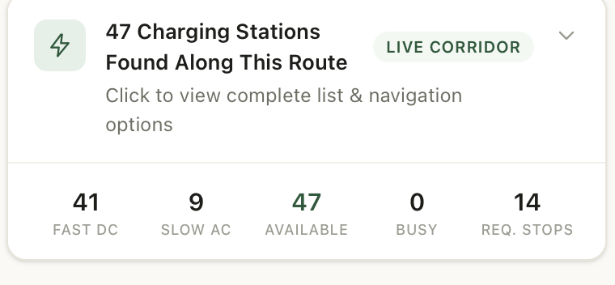
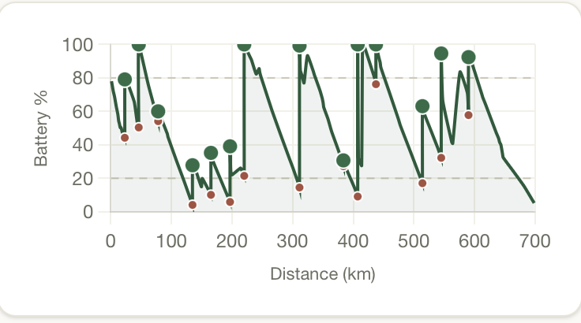
06
PROVE
Prototype + proof
Do not describe the product when you can show it. Use real screens, outputs, tests and evidence.
SCREEN 3
INSERT: POST /route/reroute-stop response — a real reroute when a planned charger fails
HERO SCREEN / WORKING PROTOTYPE
INSERT: charging strategy view — stop sequence, charge-to-% targets, ranked backups per stop
PROOF
A working charging-strategy engine, not just a router
• R² = 0.991, MAE = 0.99 kWh energy model (re-run and verified) underpins the whole plan
• Dijkstra stop planning + top-3 ranked backups + live /route/reroute-stop, over 449 real stations
• github.com/TheGD26/RouteVolt
06 / 08
Notes:
SAY: don't over-narrate this slide — let the screenshots (once inserted) do the work, then land the PROOF card.
VISUAL: insert real screenshots per the captions before presenting — RouteResults (Route A/B/C), StationCard, and a real API response. If time is short, screenshot the running app tonight.
TECH DETAIL: the R²=0.991 / MAE=0.99kWh number was produced by re-running train_model.py + the actual held-out trip_energy_test.csv (2,000 rows) live during deck preparation — it is not a number pulled from a comment or doc.
LIKELY Q: "Can you show it live?" A: Yes if the local server is running — POST /route/optimize with a real origin/destination returns the full charging_plan JSON.

Slide 7
07
PROVE
Impact + feasibility
Quantify the value, show what you validated and acknowledge what still needs to be solved.
99.1%
449
≤80%
Real-trip validation
R² of the energy model on 2,000 unseen test trips
real Tamil Nadu charging stations catalogued
default ceiling — raised only when the leg ahead or a ranked backup genuinely needs more
test the model against real driving data, not just synthetic test rows
FEASIBILITY
SCALABILITY
R
RISKS + ETHICS
F
S
Runs today on free public APIs. Building one trip's full station graph (real routes + traffic per edge) takes ~250s — a real, measured cost, and the top target before live deployment.
The ML model is fast and stateless. The real current bottleneck is the ~250s graph-build per trip — caching and self-hosted routing are the next steps before scaling past a handful of concurrent trips.
Model trained on synthetic, not real, driving data • mis-routing to an incompatible/busy charger • 12% safety margin + charge targets sized to reach ranked backups + live reroute-on-failure + UNKNOWN-connector fallback
07 / 08
Notes:
SAY: be upfront that the 99.1% R² is measured on synthetic (physics-simulated) test data, not real-world driving — that's honest and it's the very next milestone.
VISUAL: the four stat cards are all real, sourced numbers — no invented percentages.
TECH DETAIL: scalability bottleneck is third-party traffic API rate limits (Ola/Google), not model inference, which is a fast pre-loaded pipeline. SQLite -> Postgres is a one-line config change already anticipated in db.py.
LIKELY Q: "What's your model's real-world accuracy?" A: Unknown yet — it's only been validated on synthetic physics-based test data. That's explicitly flagged as the next milestone, not claimed as done.

Slide 8
08
CLOSE
Why this project should win
End with evidence, not adjectives. Make the judges remember one clear reason to choose you.
OUR STRONGEST CASE
RouteVolt doesn't just route an EV to its destination — it plans the entire charging strategy: which stops, how much to charge, and what to do if one of them lets you down.
NEXT 90 DAYS
01
Validate the energy model against real, non-synthetic driving data
01
REAL PROBLEM
REAL PROOF
REAL IMPACT
Cut the ~250s station-graph build time — cache/self-host routing so the strategy resolves in real time
02
03
02
EV drivers still make every charging decision themselves — where to stop, how much to charge, what to do if a station fails — apps only show pins
A Dijkstra-optimized stop sequence, charge targets sized against ranked backups, and a live reroute-on-failure endpoint — running on a model at R²=0.991 over 449 real stations
Fewer decisions, less waiting, more confidence — across Tamil Nadu's EV corridors
03
Pilot the full plan → charge → backup → reroute loop with real EV drivers on a real Chennai corridor
THANK YOU
github.com/TheGD26/RouteVolt
08 / 08
Notes:
SAY: land the one-sentence case, then the three 90-day milestones — all scoped to what's actually next given today's implementation, not generic promises.
VISUAL: swap the GitHub link for a QR code if presenting in person.
TECH DETAIL: none new — this slide is a synthesis of slides 4-7.
LIKELY Q: "Why should this win over other AI-for-mobility projects?" A: Most hackathon EV projects stop at charger-discovery UI; RouteVolt has a trained, tested prediction model wired into a real multi-stop simulator over a real 449-station dataset — verifiable end to end, not a mockup.

